Slide 1
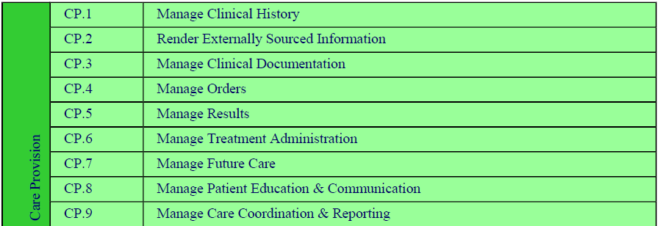
Care Provision

Slide 2
EHR Functional Lists (HL7)
Patient History lists –
Allergies
Medications
Immunizations
Medical Equipment
Orders/Interventions
Results
Encounters
Observations
Providers

Slide 3
RCCCP Classification (Based on QED and RECON)
Common Observations
Diagnostic Results
Concerns and Allergies
Conditions
Intolerances
Risk Factors
Medications
Immunizations
Professional Services
Notes:
http://www.ihe.net/Technical_Framework/upload/IHE_PCC_Query_for_Existing_Data_QED_Supplement_TI_2008-08-22.pdf

Slide 4
Categorizations
RCCCP Classification
EHR Functional Lists (HL7)
Common Observations
Diagnostic Results
Concerns and Allergies
Conditions
Intolerances
Risk Factors
Medications
Immunizations
Professional Services
Patient History lists –
Allergies
Medications
Immunizations
Medical Equipment
Orders/Interventions
Results
Encounters
Observations
Providers

Slide 5
Reconciliation of the following is needed
Concerns and Allergies
Risk factors
Patient History list - social and family history, etc
Intolerances
Allergy, Intolerance, and Adverse Reaction list [RECON]
Conditions
Problem List – e.g. conditions [RECON], diagnosis[RECON], discharge diagnosis, etc
Medication
Medication List – e.g. medication list[RECON], discharge medication, admission medication, etc
Immunizations
Immunization List – e.g immunization administered, not administered, etc
Common Observations
Medical equipment, Prosthetic/Orthotic, Device list – e.g. implanted, external devices, supplies, etc
Orders/interventions– e.g. performables, orderables, etc
Observations – e.g. vital signs, measurements used for trending, goals, etc
Diagnostic Results
Results – e.g. lab results, diagnostic results, etc
Professional Services
Encounters – e.g. planned encounters, historical encounters, etc
Providers – e.g. care team members

